Slide 1


Slide 2
Cryptarithmetic 1.1

Slide 3
Introduction
Cryptarithmetic problems are mathematical puzzles in which the digits are replaced by letters of the alphabet.

Slide 4
Rules for Solving Cryptarithmetic Problems
Each Letter, Symbol represents only one digit throughout the problem.
Numbers must not begin with zero i.e. 0567 (wrong), 567 (correct).
The aim is to find the value of each letter in the Cryptarithmetic problems
There must be only one solution to the Cryptarithmetic problems
The numerical base, unless specifically stated, is 10.
After replacing letters with their digits, the resulting arithmetic operations must be correct.
Carryover can only be 1 in Cryptarithmetic problems involving 2 numbers.

Slide 5
Question 1:
LET + LEE = ALL , then A + L + L = ?
Assume (E=5)
a)L
b)E
c)T
d)A

Slide 6
Notes:
L = 1 E = 5 T = 6
So,
1 5 6
1 5 5 (+)
-------
3 1 1
-------
A = 3 So, 3 + 1 + 1 = 5 ==> E

Slide 7
Question 2:
If KANSAS + OHIO = OREGON Then find the value of G + R + O + S + S
Assume (O=5)
a)7
b)8
c)9
d)10

Slide 8
Notes:
KANSAS + OHIO = OREGON given the value of O = 5
KANSAS = 497292
OHIO = 5865
OREGON = 503157
G + R + O + S + S = 1 + 0 + 5 + 2 + 2 = 10

Slide 9
Question 3:
HERE = COMES - SHE, (Assume S = 8) Find the value of R + H + O
a)12
b)13
c)14
d)15

Slide 10
Notes:
E + E = 8
then,E = 4 S = 8,
E + S = M
4 + 8 = 12
M = 2
H + 1 = 10 so, O = 0 C = 1,
now R + H = E = 4
H = 9
so R has to be 5 as 5 + 9 = 14 which leaves carry 1..
so M = 3
So R + H + O = 5 + 9 + 0 = 14

Slide 11
Question 4:
If POINT + ZERO = ENERGY, then E + N + E + R + G + Y = ?
a)17
b)18
c)19
d)20

Slide 12
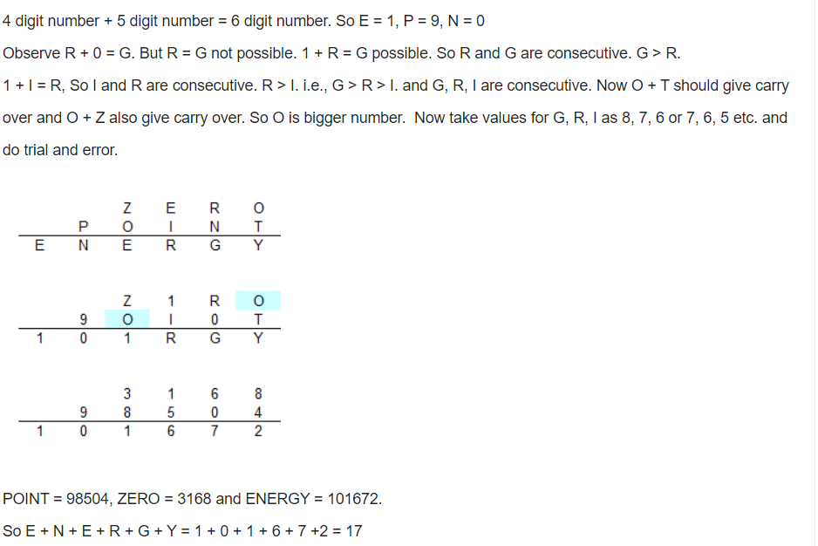
Notes:

Slide 13
Question 5:
SEND + MORE = MONEY. Then what is the value of M + O + N + E + Y ?
a)14
b)15
c)16
d)17

Slide 14
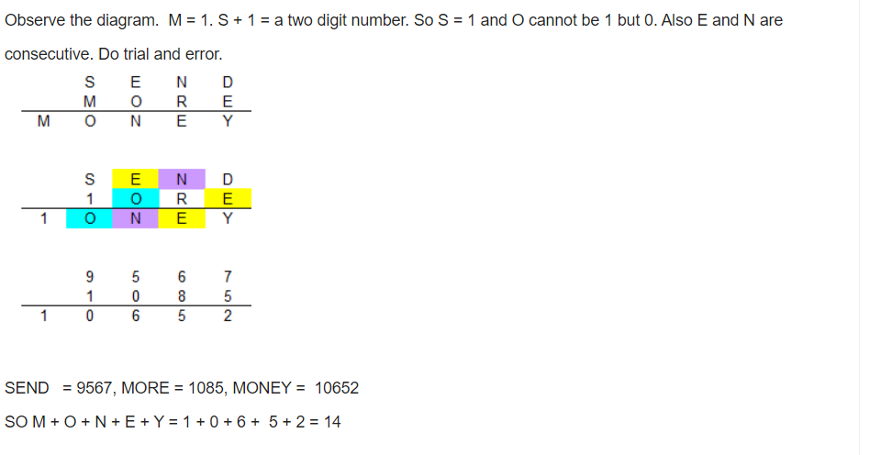
Notes:

Slide 15
Question 6:
USA + USSR = PEACE ; P + E + A + C + E = ?
a)9
b)15
c)10
d)17

Slide 16
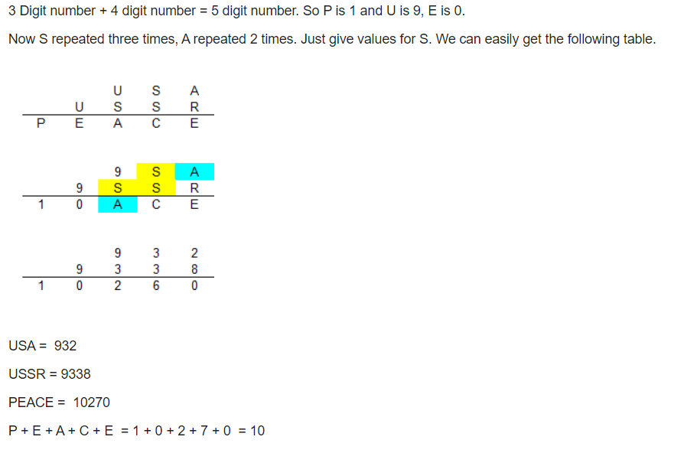
Notes:

Slide 17
Question 7:
If GO + TO = OUT, then O + U + T = ?
a)1
b)2
c)3
d)4

Slide 18
Notes:
Clearly, O = 1., as it is the carry generated by G + T. A number cannot start from 0 in cryptarithmetic addition.
Since O = 1, O + O = 1 + 1 =2. So, T = 2.
G + 2 = 10 + U.
If G = 9, U = 1. Which is not valid since O = 1.
So, G = 8 and U = 0.
Hence, O + U + T = 1 + 0 + 2 = 3

Slide 19
Question 8:
If EVER + SINCE = DARWIN then D + A + R + W + I + N is?
a)1
b)2
c)3
d)4

Slide 20
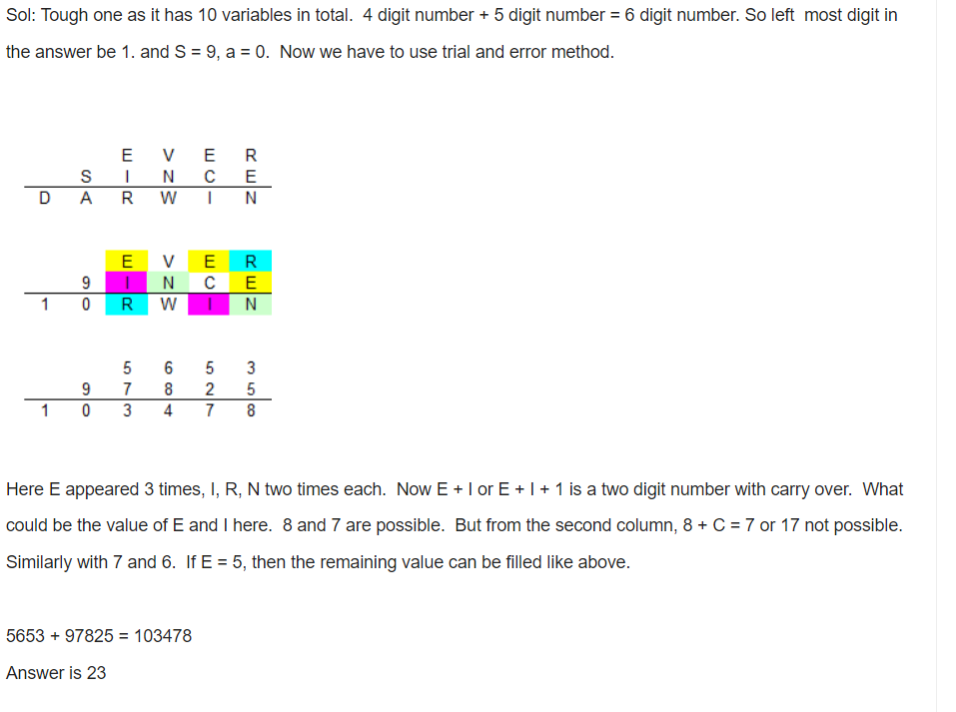
Notes:

Slide 21
Question 9:
EAT + EAT + EAT = BEET if t = 0 then what will the value of TEE + TEE?
a)088
b)084
c)044
d)048

Slide 22
Notes:
T = 0
A = 8
E = 4
EAT = 480
EAT = 480
EAT = 480
-------------
1440
8 + 8 + 8 = 24
2 carry over
4 + 4 + 4 = 12 + 2 = 14
So, BEET = 1440
the TEE + TEE
044 + 044 = 088 = TAA

Slide 23
Question 10:
If E A T + T H A T = A P P L E, what is the value of A + T + L ?
a)12
b)13
c)14
d)8

Slide 24
Notes:
3 digit number (EAT) + 4 digit number(THAT) = 5 digit number(APPLE)
If so, then A can be 1 and p can be 0.
Again here T is yielding a two digit number(10).
So there must be a carry 1 and T = 9.
Now the expression becomes
E 1 9
9 H 1 9
-------------------
1 0 0 L E
Now it is clear that E = 8 and L = 3
So,A + T + L = 1 + 9 + 3 =13

Slide 25
Exercise 1:
If WAIT + ALL = GIFTS then whats the value of G + I + F + T .. IF A = 6 and S = 5
Notes:
ANS:11

Slide 26
Exercise 2:
SEND + MORE = MONEY, What is the value of M + O + N + E + Y?
Notes:
ANS:14

Slide 27
Exercise 3:
SCOOBY + DOOO = BUSTED;Find the value of B + U + S + T + E + D?
Notes:
ANS:24

Slide 28
Exercise 4:
S C O O B Y + D O O = B L I N K Sthen B + L + I + N + K + S = ?
Notes:
ANS:28

Slide 29
Exercise 5:
BANANA + GUAVA = ORANGE ,O + R + A + N + G + E = ?
Notes:
ANS:31

Slide 30
THANK YOU

